Slide 1
Study Abroad: Spain 2024
Class #1 – November 29, 2023
Bienvenidos

Slide 2
7 months until Spain!

Slide 3
Reminder: This is a course
Four Night Classes
Travel
Project

Slide 4
Agenda
Did you sign in??
Get to know your chaperones
Charter Bus Info
Updates on Flight
Itinerary
Passports
Travel Reminders – covid related (vaccines, testing, masks)
Food
Project
Groups – read and confirm CBSD policies & Project

Slide 5
JUGAREMOS...
GET TO KNOW YOUR CHAPERONES!!

Slide 6
Directions:
Scan the QR code.
Match the chaperone with the fun fact!
Submit answers.
Let’s check!

Slide 8
Even though this person is a Spanish teacher, the first time they went to Spain they communicated by speaking Italian, not Spanish.
Sra. Poblano

Slide 9
This chaperone pole vaulted and hurdled in high school! They also were a student in salamanca.
Srta. Hughes

Slide 10
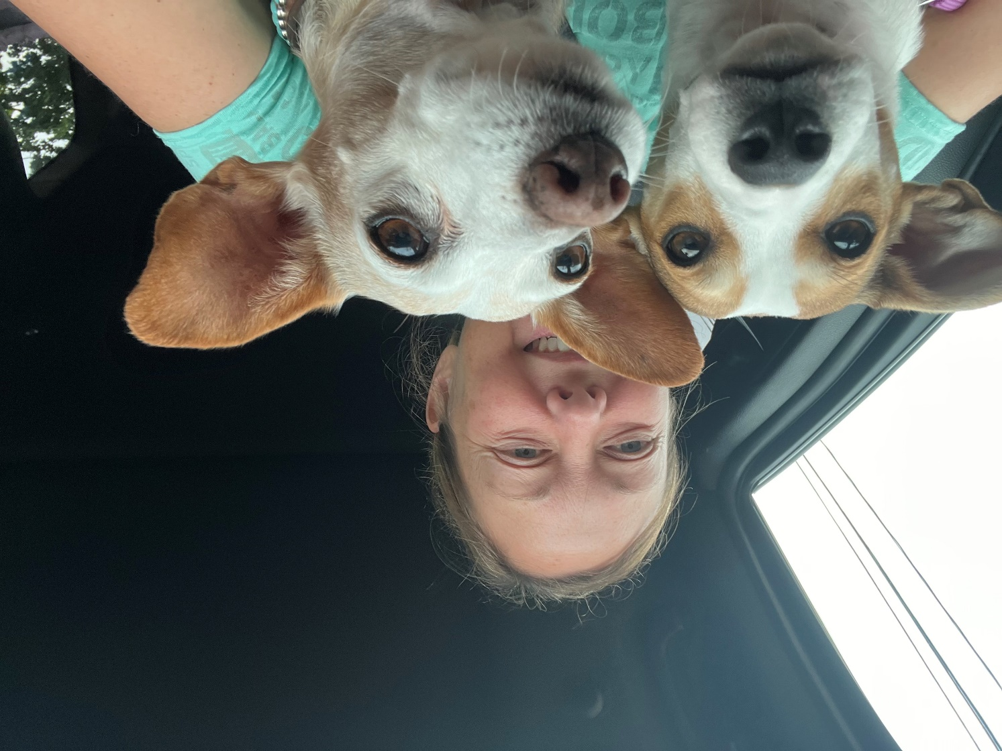
This person has successfully travelled with 498 CB students to France and Spain in the past 9 years and 100% of them came back unscathed! This person also collects and loves all things related to dacshunds.
Srta. Gray

Slide 11
This person was a gymnast for 16 years and later became an instructor.
Sr. Palmer

Slide 12
They won a car on the price is right with Bob Barker!
Sra. Field

Slide 13
The price is right february 4, 2005
Sra. Field

Slide 14
This chaperone loves family traditions and huge family dinners! Their family has posed with Santa family pictures for 22 years
Sra. Thomas

Slide 15
This chaperone took an art class at CB West with Pink!
Dr. Lake

Slide 16
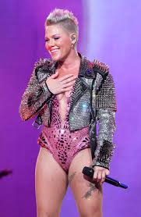
Alecia Moore
I remember that guy!

Slide 17
This chaperone is a citizen of San Marino.
Srta. Stein

Slide 18
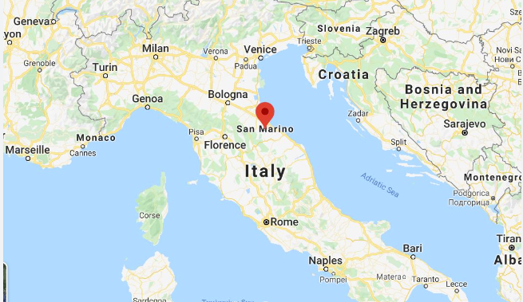
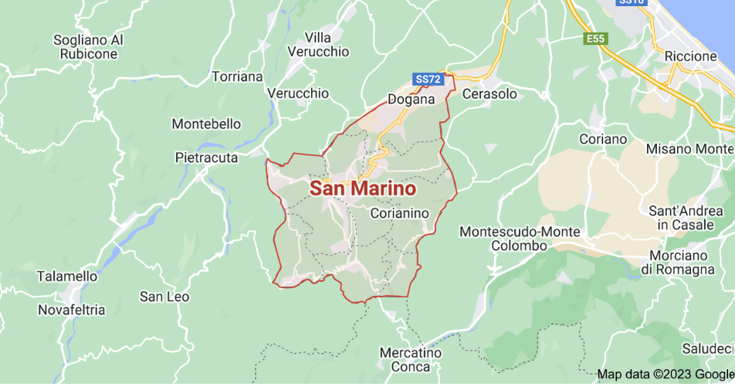
San Marino, small, landlocked republic situated on the slopes of Mount Titano, on the Adriatic side of central Italy between the Emilia-Romagna and Marche regions and surrounded on all sides by the republic of Italy. It is the smallest independent state in Europe after Vatican City and Monaco and, until the independence of Nauru (1968), the smallest republic in the world.
San Marino | Geography, History, Capital, & Language | Britannica

Slide 19
What do our chaperones have to say about travel?

Slide 20
Continuamos...
You will get to know your chaperones better in small groups tonight.
Let's work though the agenda in order of occurrence...

Slide 21
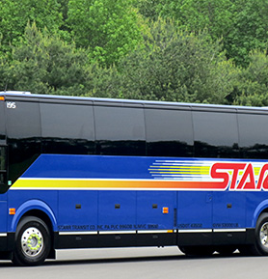
Charter Bus Information & Tips
Leaving from CB South High School
Each student pays approximately $75 for bus to/from airport
Students are dropped off at SOUTH on June 29th and picked up at SOUTH on July 8th
Tips appx. $30-$50 cash
Bus money and tip money will be collected in the spring of 2024

Slide 22
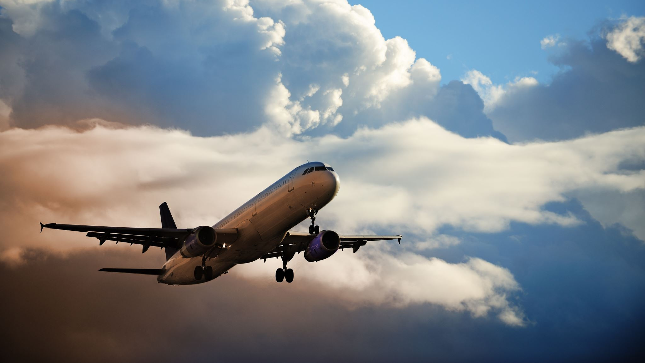
Flight information
Stay Tuned…

Slide 23
Itinerary

Slide 24
Passports
Raise your hand if you have one!
PLEASE LET ME KNOW IF YOU HAVE A PASSPORT FROM A COUNTRY OTHER THAN THE U.S.

Slide 25
OBTAINING A U.S. PASSPORT
U.S. DEPARTMENT OF STATE
If you need a passport, visit travel.state.gov for information on how to obtain one.
Passports must be uploaded as a JPG to your T&E profile ASAP. You will also need to turn in a color paper copy in the spring to me.

Slide 26
PASSPORTS
Students will hold onto their passports using a lanyard worn their neck until we arrive in France. They will not remove it.
Chaperones will collect all passports and keep them locked up until it’s time to go home.

Slide 27
PASSPORTS
If you already have a passport and have not done so yet, please check the expiration date.
Children under the age of 16 only have a 5-year passport.
Children 16+ have a 10-year passport.

Slide 28
PASSPORTS
It is a U.S. REGULATION that your passport NOT expire within 6 months of the departure or return of the trip.
THEREFORE:
If your passport expires between January 2024 – January 2025, you will need to apply for a renewal ASAP.

Slide 29
PASSPORT REQUIREMENTS

Slide 30
PASSPORT PROCEDURES
Fill Out Form DS-11:
Application For A U.S. Passport
**need Social Security number
**online or by hand
Submit Completed Form DS-11
*in Person.
See website for places to do this
Submit Evidence of U.S. Citizenship
*birth certificate
Present Identification
Submit a Photocopy of the Identification Document(s) Presented (Step 4)
Pay the Applicable Fee
*minors $95 + ($35 fees)= $130
Provide One Passport Photo
*Rite Aid, CVS, etc.

Slide 31
Covid-related travel possibilities
As of today, there are no covid restrictions and no vaccination proof required.

Slide 32
Masks
If Spain mandates masks – everyone will wear a mask.
If CERTAIN venues mandate masks - everyone will wear a mask in that venue.
END OF THE DISCUSSION.

Slide 33
NAME & EMAIL
Be sure your name is entered in the T&E portal EXACTLY as it appears on your Passport.
PARENTS: if you are NOT receiving emails from Srta. Gray, please let me know ASAP, as email is our ONLY method of communication.
STUDENTS: Be sure to tell your parents each time you receive an email as well.

Slide 34
La comida - food
All chaperones and students will need to fill out a form for T&E if you have allergies, dietary restrictions or a specific diet.
Be open minded and try new things!
We will double check with you at another meeting about your dietary needs/preferences.

Slide 35
Medications
Please list any prescribed medications you take in the T&E student profile as well.
Students may keep over the counter medications – if you know about it and are okay with them holding onto it.
We ask that parents please double check this information for accuracy, as it is an essential safety item for us to be aware of while traveling abroad.
YOU WILL RECEIVE A MICROSOFT FORMS AT A LATER DATE TO UPLOAD A PICTURE OF ANY PRESCRIBED MEDICATION(S) THAT YOUR CHILD TAKES.

Slide 36
Chaperone groups
Chaperone groups are together for the following reasons:
Going through security and the airport
Boarding the plane, getting on buses, leaving restaurants, museums, parks etc.
Checking in – we will do this every day, multiple times a day.
You may or may not be in the same chaperone group as your friends. These groups do not dictate your social life throughout the trip. AND one of our objectives is to help you get out of your comfort zone and meet new people!

Slide 37
Project
You will choose a topic
You will create a guiding question
You will submit the topic and question in Canvas – you may change this before we leave if necessary
Take pictures, video and collect evidence and observations while we are in Spain
Submit the project and reflection in Canvas on or before August 9, 2024.
Receive .25 elective credit and a P for PASS on your transcript.
*If you do not complete the project, you will receive an F on your transcript.
You will complete the interpretive task before we leave
You will record an interpersonal task while abroad

Slide 38
Enroll in the Canvas course
You should have received the self-enrollment link yesterday in an email from me.
Please enroll now if you have not yet done so.
https://cbsd.instructure.com/enroll/ANLTKJ

Slide 39
Warning
Students are NOT permitted to meet up with anyone that they have met online.
Any attempt to do so will result in your being sent home at the expense of your family.

Slide 40
breakout session to-do list
1. INTRODUCE YOURSELVES TO YOUR CHAPERONE AND GROUP MEMBERS
2. ENROLL IN CANVAS COURSE
3.. Read CBSD School Board Policies:
#221 DRESS AND GROOMING
#222 TOBACCO AND VAPING
#227 CONTROLLED SUBSTANCES
#231 STUDENT TRAVEL
4. Discuss possible topics for projects
Take Quiz

Slide 41
CHECK IN!
STUDENTS
CHECK THE LISTS HANGING IN THE LIBRARY
CHAPERONES
HOLD UP GREEN WHEN ALL OF YOUR GROUP MEMBERS ARE PRESENT
HOLD UP RED IF YOU ARE MISSING GROUP MEMBERS

Slide 43
Meeting Dates:
All meetings are at CB SOUTH in the LIBRARY at 6:00PM
January 31, 2024
March 20, 2024
June 5, 2024
If you are sick and cannot attend a meeting, the student must email Ms. Gray directly at SLGRAY@cbsd.org

